Slide 1
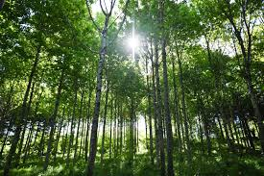
By Kate

Slide 2
Trees are important because they are animals homes,they give us oxygen and they are an important part of many cycles and food chains

Slide 3
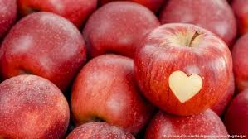
Trees produce many things like wood,paper and food.

Slide 4
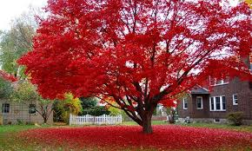
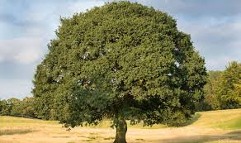
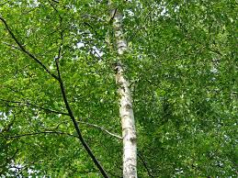
There are 60,065 kinds of tree. The most popular kind are oak and maple
but there are many different kinds of maple,oak ,birch etc…

Slide 5
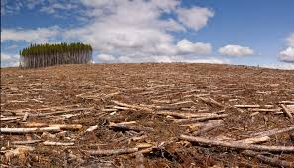
Every day millions of trees are cut down .Some of the many things we can
Do to prevent this are using less paper,plant trees and recycle paper and
Cardboard.

Slide 6
I hope that you now know the importance of trees. I also hope that you have
Enjoyed My powerpoint.

