Slide 1
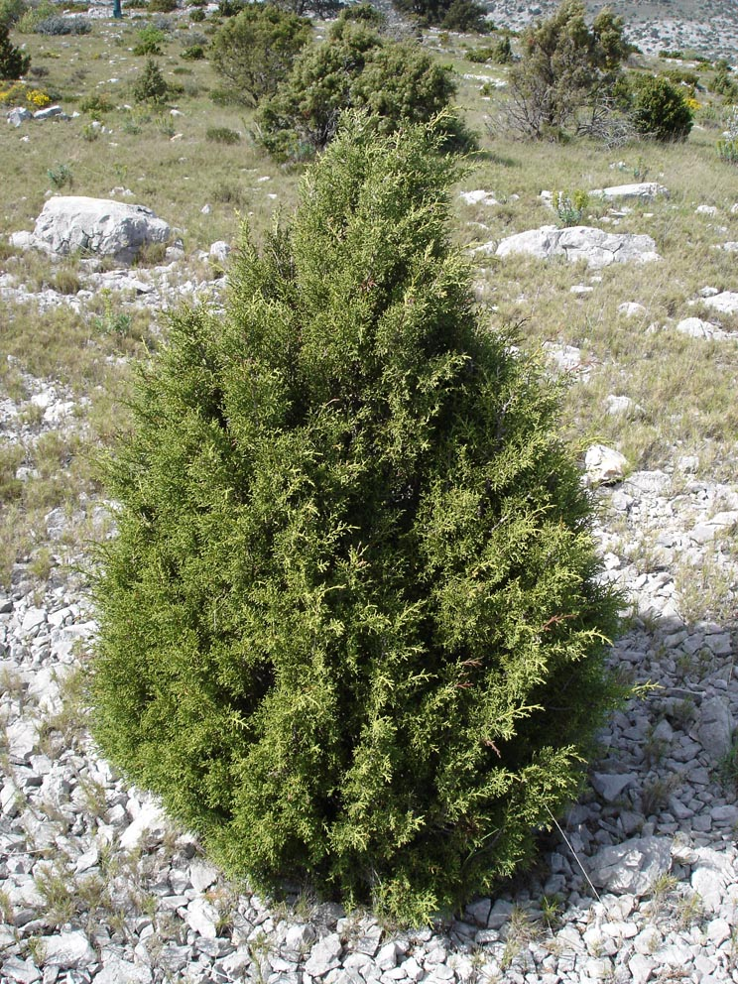
Wonderful trees
By Niall

Slide 2
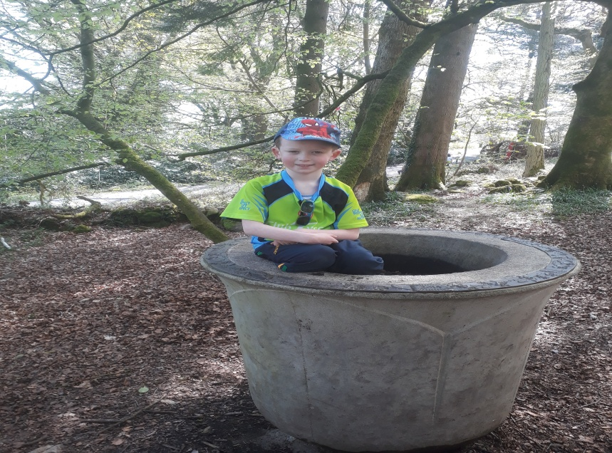
Introduction.
This power point is all about trees. Trees are a important thing in life and we would not be living on this earth if it wasn’t for them. You will learn about that later. I hope you enjoy this power point about trees and lets get straight into it!

Slide 3
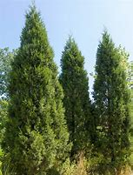
WHY ARE TREES IMPORTANT?
Trees are important because they produce oxygen and without it we would not be able to breathe. Trees are also important because they cover about 30 percent of the earth’s land surface.

Slide 4
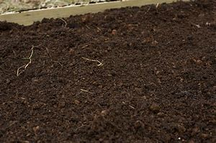
trees and soil.
There is a very close relationship between trees and the soils they grow in. The soil is the storage place for water and the nutrients which are needed by the trees to grow. The roots of the tree make a base in the soil. Forest soil and the trees provide food for animals and plants.

Slide 5
Having FUN CLIMBING TREES

