Slide 1
Guidance for Video/Audio in PowerPoints
1. Open the folder and copy all the files.
2. Paste the copied files into a new folder.
3. Open the PowerPoint file, enable editing and enter presentation mode (start the slide show).
Please note the embedded audio may not be compatible with early versions of PowerPoint.
You may wish to delete this slide before beginning the presentation.

Slide 3
Notes for Practitioners
Super Soap’s Handwashing Story can be used to teach young children about the importance of washing their hands regularly and when to wash their hands. It can be used as a fun way to discuss different reasons why we should wash our hands.
Throughout the story, Super Soap will prompt the characters to think about the activities that they are doing and when they should be washing their hands. You may like to ask the children similar questions to initiate discussions about handwashing and why it is important to wash their hands.
A catchy song (to the tune of ‘Twinkle, Twinkle, Little Star’) is included in the story to reinforce the key handwashing message. Encourage the children to join in with the song to help them to remember how to wash their hands.

Slide 4
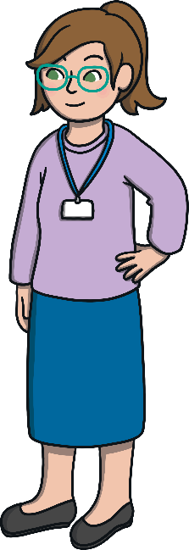
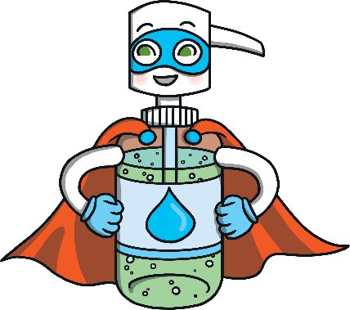
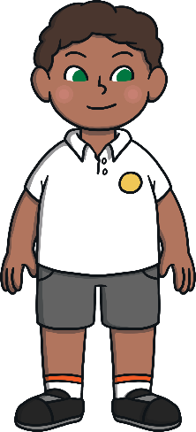
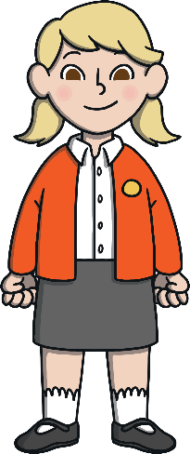
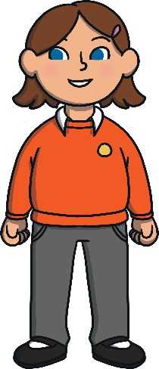
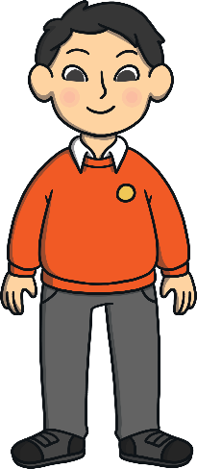
Characters
There are 6 characters that the children will meet in this story.
Miss Molly
Super Soap
Tommy
Ava
Mila
Ollie

Slide 5
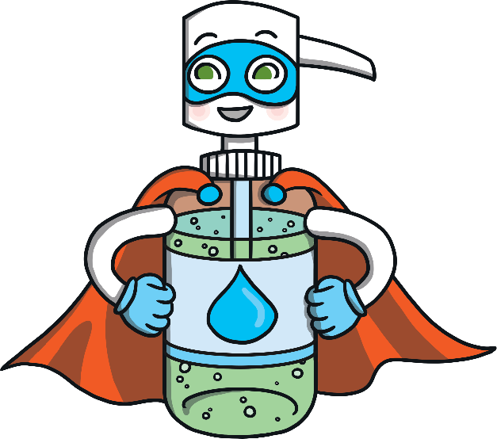
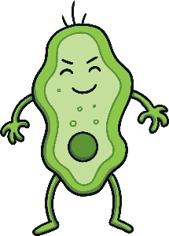
Hi! I’m Super Soap. I have a very important job. I am on a special mission to protect children from germs.
Do you know what germs are? Let me tell you about them.
Germs can be found in lots of places and are so small that we can’t see them. Sometimes, we might touch something that has germs on. If we then touch our face, the germs can sneak inside our bodies and sometimes this might make us feel poorly.
I’m here to help you learn how you can keep yourself safe from these germs!
How do you think we can protect ourselves from germs?

Slide 6
Germs can be spread by things like sneezing and coughing. Germs can land on the toys that you are playing with. Washing your hands is the most important way to stop germs spreading. Germs don’t like soap and water!
That’s why I am here to remind children to wash their hands. I can teach you a fun song to sing to make sure you get your hands nice and clean!
Can you think of a time when you might need to wash your hands?
In this story, you’ll see me reminding the children to wash their hands. Can you help me in my special mission?
Can you remember what my special mission is?

Slide 7
Super Soap’s Song
Over, under, round and through, Don’t forget to add soap too.
Clean, clean, clean and then you'll know, Down the sink the germs will go.
Over, under, round and through, Don’t forget to dry them too.
over
through
under
round
Can you do these actions to help you remember how to wash your hands?

Slide 8
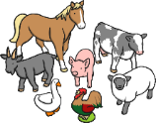
It was an exciting Monday morning in school and Miss Molly had set up lots of wonderful activities for the children to try.
Tommy, Ava, Mila and Ollie came in to class and they could not wait to join in with all the activities.
Can you help me to protect the children from germs by reminding them when they should wash their hands?

Slide 9
Tommy looked around deciding what he would play with first. He could play with the building blocks or even the toy farm. He loved all of the mini animals! Tommy began to walk towards the toy farm wondering which animals were hiding in the barn.
What should Tommy do when he first arrives at school?

Slide 10
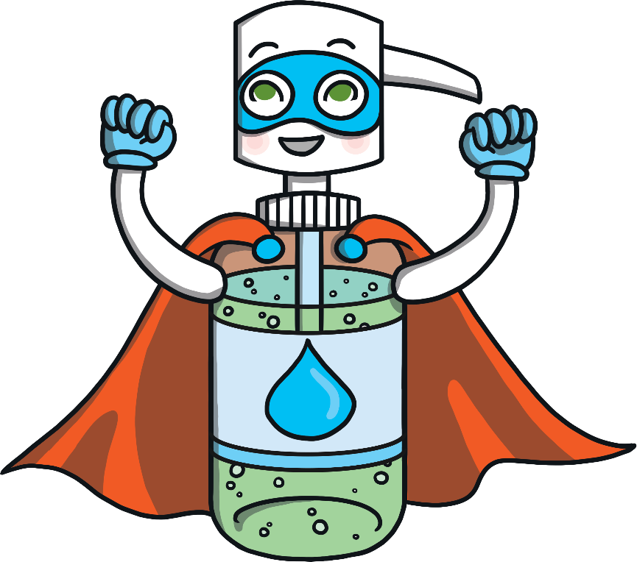
On a mission to protect children from germs, Super Soap swooped through the air and landed next to Tommy, saying…
You’ve just arrived at school to play, wash your hands to start the day!

Slide 11
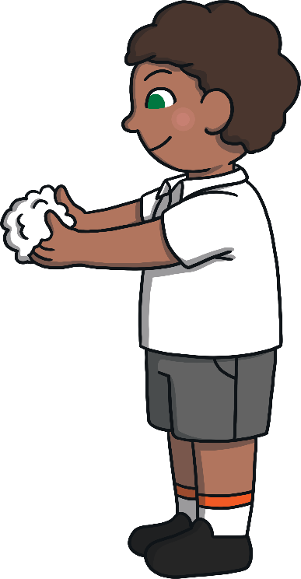
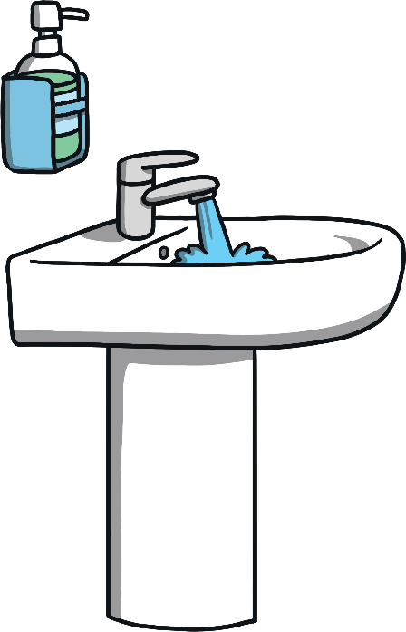
Tommy followed Super Soap to the sink. Super Soap sang his song to help Tommy wash his hands.
Over, under, round and through, Don’t forget to add soap too.
Clean, clean, clean and then you'll know, Down the sink the germs will go.
Over, under, round and through, Don’t forget to dry them too.

Slide 12
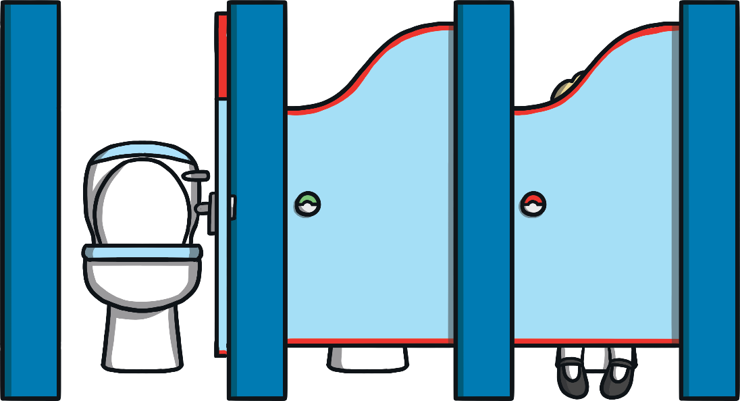
Ava looked at the garden and rushed outside. She had a very busy time playing with her friends. They had been building a den in the garden. She felt a little feeling in her tummy and noticed she needed the toilet. Ava took herself indoors to the toilet.
After she had finished and flushed the toilet, Ava opened the door and went to go and join her friends again.
What should Ava do after going to the toilet?

Slide 13
Super Soap needed to continue his mission. He couldn’t let Ava return to her friends without washing her hands. Super Soap darted over to her and said…
You’ve been to the toilet
so now it’s time, to wash your hands to the Super Soap rhyme!

Slide 14
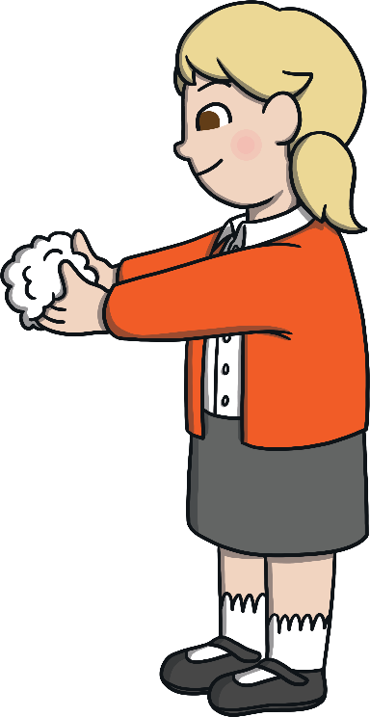
Ava went back to the sink. She joined in as Super Soap started to sing his song.
Over, under, round and through, Don’t forget to add soap too.
Clean, clean, clean and then you'll know, Down the sink the germs will go.
Over, under, round and through, Don’t forget to dry them too.

Slide 15
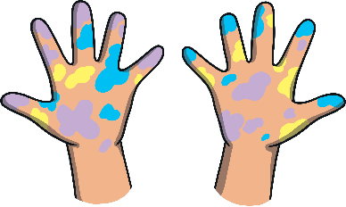
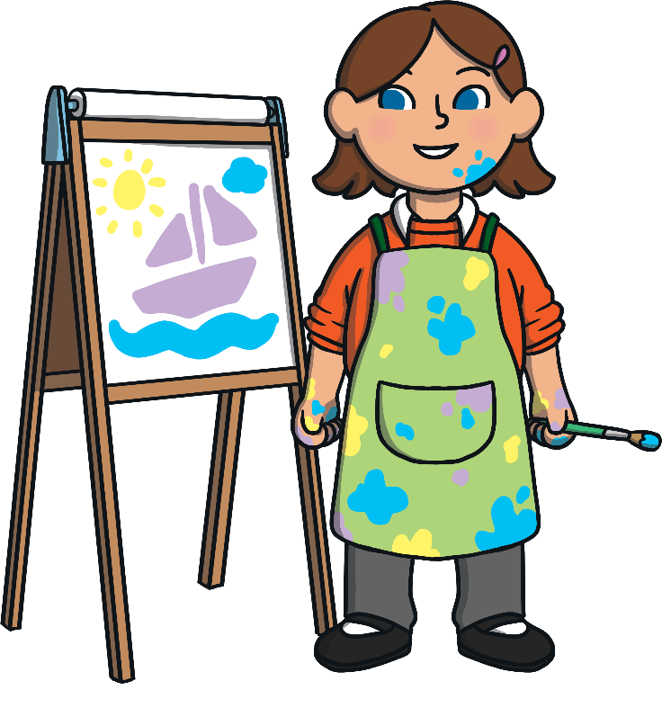
Mila was excited to see the paint out because she loves painting. Mila used the paint to mix different colours and painted a beautiful boat.
As Mila finished her painting, she noticed that she had paint on her hands.
Can you tell Mila what she needs to do now?

Slide 16
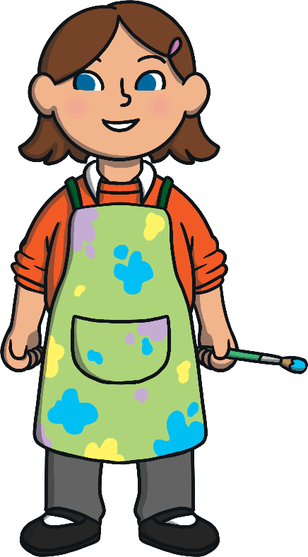
With a whizz and a whoosh, Super Soap flew over to Mila to continue his mission to protect the children from germs!
He smiled at her and said…
Playing with paint is so much fun, wash your hands now that you’re done.

Slide 17
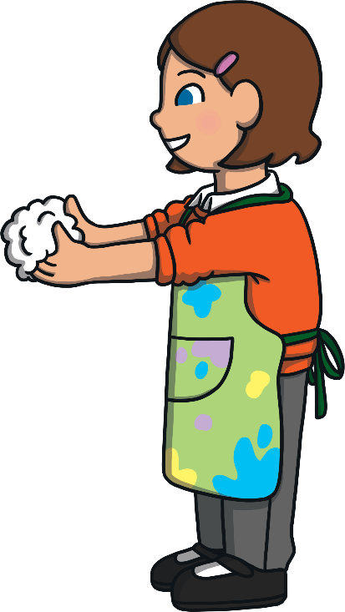
Mila headed to the sink. Suddenly, Super Soap burst in to song!
Over, under, round and through, Don’t forget to add soap too.
Clean, clean, clean and then you'll know, Down the sink the germs will go.
Over, under, round and through, Don’t forget to dry them too.

Slide 18
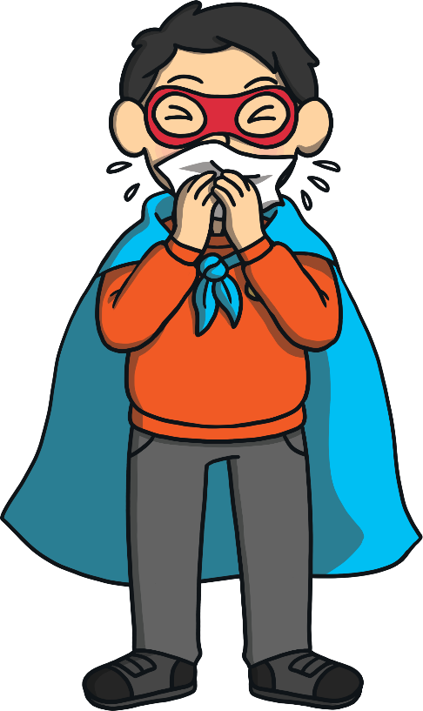
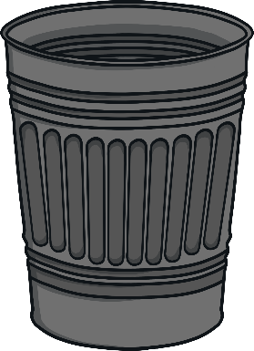
Ollie headed straight for the role-play area. He spotted the new superhero outfit with the matching mask. All of a sudden, Ollie felt a tickle in his nose. He lifted up the mask, got a tissue and blew his nose. Once Ollie had finished, he put the tissue in the bin.
What could be on Ollie’s hands now?

Slide 19
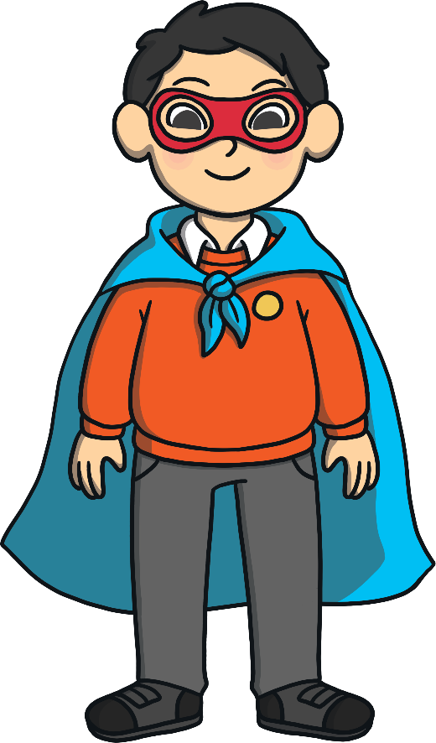
Super Soap was here to save the day, continuing his mission to protect the children from germs. He rushed through the air to Ollie and said…
If you need to blow your nose, wash your hands and the germs will go.

Slide 20
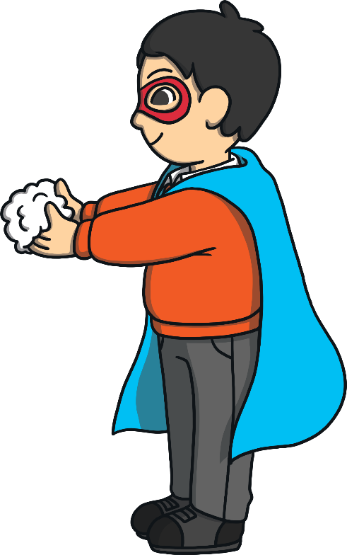
Ollie walked to the sink while Super Soap sang his song.
Over, under, round and through, Don’t forget to add soap too.
Clean, clean, clean and then you'll know, Down the sink the germs will go.
Over, under, round and through, Don’t forget to dry them too.

Slide 21
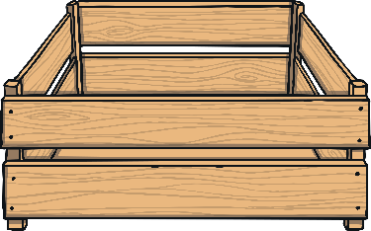
The children had been so busy and the morning had flown by. Miss Molly called the children over to get their snack. They finished the activities they were doing and headed for the snack line.
Why should the children wash their hands before they have their snack?

Slide 22
Super Soap swooped down with a flap of his cape and called out to the children.
Before you join in the snack line, wash your hands and you’ll be fine.

Slide 23
The children had remembered Super Soap’s song and sang it happily as they headed towards the sink.
Over, under, round and through, Don’t forget to add soap too.
Clean, clean, clean and then you'll know, Down the sink the germs will go.
Over, under, round and through, Don’t forget to dry them too.

Slide 24
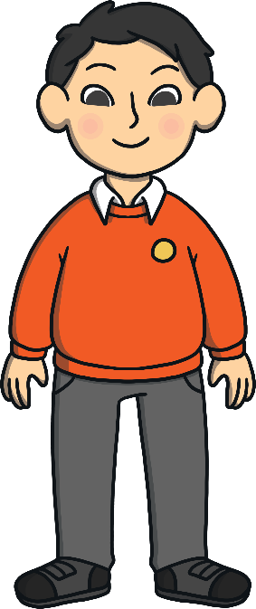
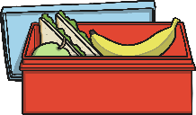
Super Soap was really pleased with the children. They were able to remember his special song to help them wash their hands properly. He watched them in class and noticed that they remembered when they needed to wash their hands.
Can you think of any other times when they should wash their hands?
I washed my hands before I ate my lunch.
I washed my hands after blowing my nose.

Slide 25
Miss Molly asked the children what they had learnt from Super Soap’s visits to their class. The children told Miss Molly what they had found out about germs and how to protect themselves.
We should wash our hands before we eat.
We should always wash our hands when we have been to the toilet.
Do you think the children know how to protect themselves from germs?
Germs are so small that we can’t see them.
Using soap and water is important to stop the germs.

Slide 26
Super Soap was happy that his mission with Tommy, Ava, Mila and Ollie was over. They now knew when and how to wash their hands. Super Soap tightened his belt, straightened his mask and raced away to another classroom to continue his mission to protect children from germs.
Can you remember the actions to my special song? It will help you to wash your hands properly!

Slide 27
Let’s sing it together!
Over, under, round and through, Don’t forget to add soap too.
Clean, clean, clean and then you'll know, Down the sink the germs will go.
Over, under, round and through, Don’t forget to dry them too.
over
through
under
round

